Slide 1
Identity Fraud Research, Remediation and Recovery Services
Sponsored by
July 10, 2014

Slide 2
Today’s Objectives
The Identity Theft Epidemic
Why Fraud-Defender
Consumer Benefits with Fraud-Defender
The Fraud-Defender Process – How It Works
Next Steps
Co-Hosts
Terry Clemans
NCRA Executive Director 630.539.1525 tclemans@ncrainc.org
Elizabeth Craig
NXG Account Manager
615.567.5775 elizabeth.craig@nxgstrategies.com

Slide 3
Leading Identity Fraud and Business Risk Mitigation Company
Principals have 30+ years of management experience
Specialists in marketing, security, retail management and compliance
Millions of consumers covered nationwide
BBB accredited since 2007 — with zero complaints
7 years of victim satisfaction survey responses — consistent 90th percentile ratings
Over 130 consumer testimonials…. Available upon request

Slide 4
Identity Fraud is a growing problem
13.1 million people affected in 2013, 500,000 increase over 2012
New identity fraud victim — every 2 seconds
Over 85 million records breached in 2013, 49% increase over 2012
— 2013 Javelin Identity Fraud Report
— 2013 Verizon Data Breach Investigations Report
— www.privacyrights.com

Slide 5
Consequences of Identity Fraud
Numerous studies (both independent and government) suggest a victim can spend many hours of their own time recovering from identity theft
Victims are also known to average about $1,400 in out-of-pocket expenses.
Majority of time spent in recovery is during normal business hours, resulting in distracted and absent employees
- The Identity Theft Resource Center, 2012 survey

Slide 6
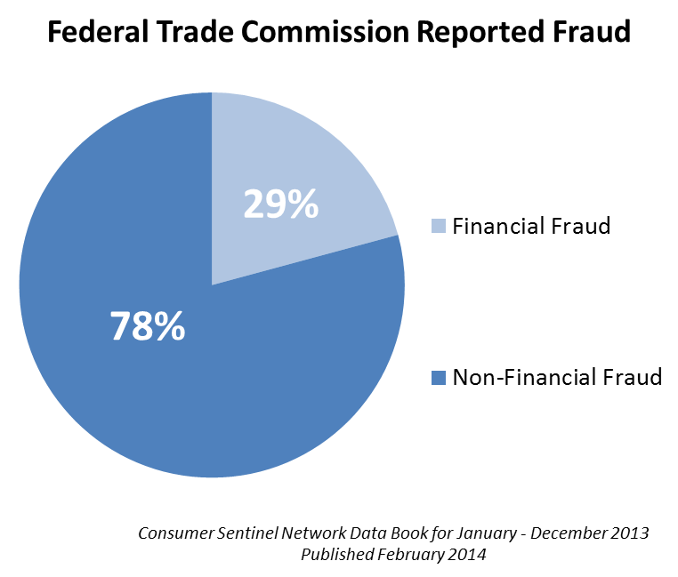
Types of Reported ID Fraud
Financial Fraud
Loan Fraud 4%
Credit Card Fraud 17%
Bank Fraud 8%
Total Financial Fraud = 29%
Non-Financial Fraud
Phone and Utilities Fraud 14%
Gov’t Docs and Benefits Fraud 34%
Employment-Related Fraud 6%
Other Fraud 24% (Medical, Internet, Insurance, etc.)
Total Non-financial Fraud = 78%
21%
79%
Percentages are based on the total number of CSN identity theft complaints for each calendar year.
16% of identity theft complaints [in 2013] include more than one type of identity theft.
Notes:
What is your first thought when identity fraud is mentioned?

Slide 7
Why Fraud-Defender?
Property Managers and Mortgage Lenders: Incent consumers to complete the application process
Deliver substantial additional value for application process – even if consumer is not approved
Assure consumers that their information is safe with your company
Provide on-going coverage to existing employees
Create an opportunity for an additional stream of new revenue
Property Managers - A major value add to your application process
Mortgage Lenders – More applicants = more closings

Slide 8
Employee Benefit
Property Managers
All property site employees receive the Fraud-Defender Identity Fraud Research, Remediation and Recovery Services.
Mortgage Lenders
All origination and processing employees receive the Fraud-Defender Identity Fraud Research, Remediation and Recovery Services.
These services are available so long as the individual remains an employee of the Sponsoring Company and the Sponsoring Company meets the minimum participation ratios.

Slide 9
Deployment of program – pending your consumer report provider
Available currently from some providers
Focused Marketing Materials
Implementation Support

Slide 10
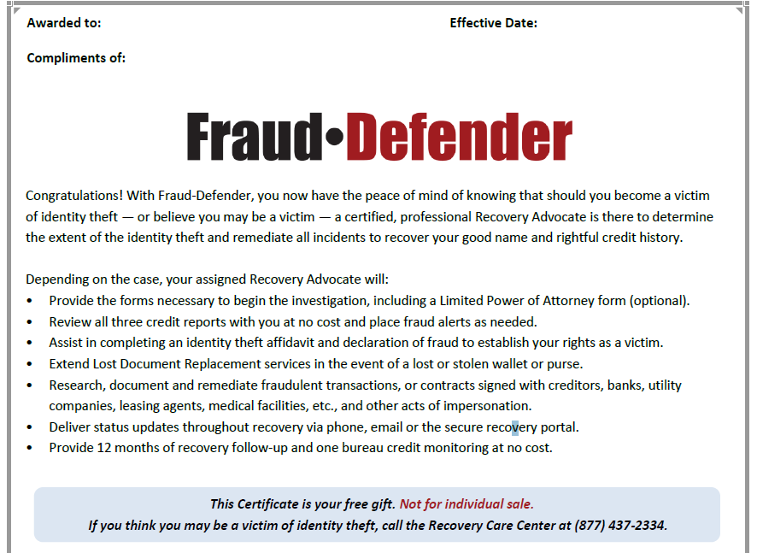
Certificate of Eligibility
Notes:
Talking points related to the tech aspect of programming the certificate for the program

Slide 11
Recovery Advocates
Credit Certifications:
FCRA & FACTA* Certified — renewed every 2 years
Identity Theft Certifications:
Licensed Private Investigators
Certified Identity Theft Risk Management Specialists (CITRMS)
Certified Financial Crimes Investigator (CFCI)
Certified Fraud Examiner (CFE)
Crisis Management Training:
Recovery Advocate Training — NXG Certified
Additional Information:
Average 20 years tenure in the Identity Fraud Industry
Access to Amcrin’s CrimeDex
*Fair Credit Reporting Act/Fair and Accurate Credit Transactions Act

Slide 12
Fully Managed Recovery Process
Certified, Professional Recovery Advocates are able to:
Complete a full Identity Fraud Threat Assessment
Review all 3 bureau credit reports for new or suspicious activity
Assist with placing fraud alerts
Activate credit monitoring during recovery and provide Credit Report and Score
Perform discovery research to uncover any additional fraud
Provide Lost Document Replacement (including Lost Wallet) services
Contact creditors and other agencies under an executed Limited Power of Attorney
Create and maintain a law enforcement grade case file, to assist law enforcement in prosecution of perpetrators
Supply victim with case status updates throughout recovery
Expunge fraudulent information from the victim’s records, with no time limit on recovery
Provide free credit monitoring and follow up with the victim for a full 12 months post-resolution

Slide 13
Family Coverage
Fully Managed Identity Fraud Research, Remediation and Recovery
Three Generations (3G) includes:
All named consumers
Spouse or domestic partner
Children under age 25 with the same permanent address
IRS qualified dependents
Parents of the consumer
With the same permanent address
In an elder care facility (nursing home, assisted living, or hospice)
All 3G family members are covered for a full 12 months after death

Slide 14
Initial Step of the Recovery Process
Consumer experiences identity fraud or believes they might be a victim
Consumer calls the Recovery Care Center directly and reports their concern
Consumer will be assigned a Recovery Advocate within that initial call and the investigation will begin
The Recovery Advocate will continue to work on the case until the victim has been returned to pre-event status
Recovery Care Center Hotline
Toll-free Hotline Answered 24x7x365
Notes:
Phone number?

Slide 15
How It Works
Sign a Fraud-Defender addendum to your contract with your Screening Report or Credit Report Provider.
Your Consumer Report bundle is updated and the Fraud-Defender Certificate of Eligibility set-up to print automatically.
An additional $5.00 charge will be added to your report costs for the 3-generation identity theft coverage.
Provide the Fraud-Defender Certificate to the consumer, with services immediately available.
Coverage extends to identity fraud events that occur prior to start of this program, so long as consumer is not aware before the program is in place.

Slide 16
How do you participate?
Contact your Screening Report or Credit Report Provider!
To find a participating Fraud-Defender Provider, call NCRA.
Terry Clemans 630.539.1525 tclemans@ncrainc.org
Jan Gerber 630.539.1525 jgerber@ncrainc.org
Andy Lomo 630.539.1525 alomo@ncrainc.org

Slide 17
Thank you for your time!
Questions?

