Slide 1
Green Incentive Data Quick Summary Report & Green Report Powered by IncentiFind

Slide 2
Terry Clemans – Executive Director Maureen Devine – Director & Strategic Alliance Chair

Slide 3
Jesse Rivera
Chief Executive Officer
Austin, Texas

Slide 4
Natalie Goodman
IncentiFind, Founder
Houston, Texas

Slide 5
Agenda
Why Incentives? Why Now?
About the Products
Quick Summary & Green Report
Value Proposition of the Products
Revenue from the Products
Accessing the Products
Q&A

Slide 6
Homeowner Pain Points
“As the single largest housing expense after a mortgage payment, ...utility costs can have a direct impact on how large a mortgage [a homeowner] can afford.¹”
Electric and water continue to rise
50% of the housing stock is 37 years or older²
51% are planning to spend $10,000 or more on an upcoming renovation²
Notes:
1)https://www.energystar.gov/newhomes/mortgage_lending_programs/energy_efficient_mortgages; https://www.energystar.gov/sites/default/files/asset/document/EEM_Fact_Sheet.pdf
2) https://realestate.usnews.com/real-estate/articles/the-guide-to-home-renovations
*Among homeowners who frequent Houzz, a home renovation and design site, 51 percent are planning to spend $10,000 or more on an upcoming renovation, according to Houzz’s 2018 U.S. renovation report.“The underlying force for that growth is the fact that 50 percent of the housing stock today is 37 years or older," and most of these aging homes have roofs, furnaces, flooring and appliances that have reached the end of their lives*

Slide 7
Commercial Pain Points
“The potential value at stake for embedding sustainability (green) is significant, and in some cases can represent a 50%+ increase in asset value.¹”
Electric and water continue to rise
50% of the commercial building stock (45 billion square feet) is 40 years old or older and has not been updated¹
Notes:
1 American Institute of Architects 2019 Report on America’s Building Stock

Slide 8
Value of Quick Summary
The QS can get CRAs into the door of lenders to differentiate themselves from the competition as well as help lenders grow their home equity, refi, new construction, and renovation portfolios.
Lenders, and those serving lenders, have an opportunity to bring valuable data that property owners are looking for

Slide 9
Value of Green Report
Credit Reporting Agencies
Competitive advantage with first mover position
Lenders
Cost savings from incentives can be used to repay loans
Borrowers/ Property Owners
Cost coconscious owners reap savings
Receive detailed report that manages their expectations (24 months)

Slide 10
12,000+ Incentives
New Construction
(Above code or achieving certification)
2,448 Energy Efficiency
648 Renewables
396 Water Conservation
1,020 Other
Brownfield Development
EV Charge Stations
Certification
Opportunity Zone
New Market Tax Credit
PACE Eligible Areas
Resilience
Existing Buildings
(Above code or achieving certification)
4,284 Energy Efficiency
1,512 Renewables
1,320 Water Conservation
1,680 Other
Historic Reuse
Beautification
Economic Development
EV Charge Stations
Certification
PACE Eligible Areas
Resilience
Incentive Categories:
tax, grants, fee waivers, rebates, bill credits

Slide 11
Who is Eligible?
Anything above building code
Most products and equipment are above code
Energy Efficiency:
LED, HVAC, Windows, Roofs, Insulation, appliances, etc.
Water Conservation:
Landscaping, faucets, toilets, showers, etc.
Renewables
Solar, Wind, Geothermal, etc.

Slide 12
Value of Our Data
QUICK SUMMARY REPORT
Single Family: 3,000 SQFT, 37 years old
CRA/ Lender Turned
$10 into $4,000
in cost-savings
Energy Efficient Roof
$30,000
Energy Efficient HVAC + Insulation
$10,000
Solar Screens on Windows
$8,000
Energy Efficient Water Heater
$2,500
GREEN REPORT
Home Equity Loan
$50,500
Borrower Turned
$99 into $4,000
in cost-savings
Cost-Savings from incentives:
-$4,000
Total:
$46,500

Slide 13
Value of Our Data
QUICK SUMMARY REPORT
Office: 300K SQFT, 40 years old
CRA/ Lender Turned
$10 into $142,500
in cost-savings
Energy Efficient Lighting
$340,000
HVAC Controls
$350,000
Commercial Loan
$690,000
GREEN REPORT
Cost-Savings from incentives:
-$190,000
Borrower Turned
$1000 into $142,500
in cost-savings
Total:
$500,000

Slide 14
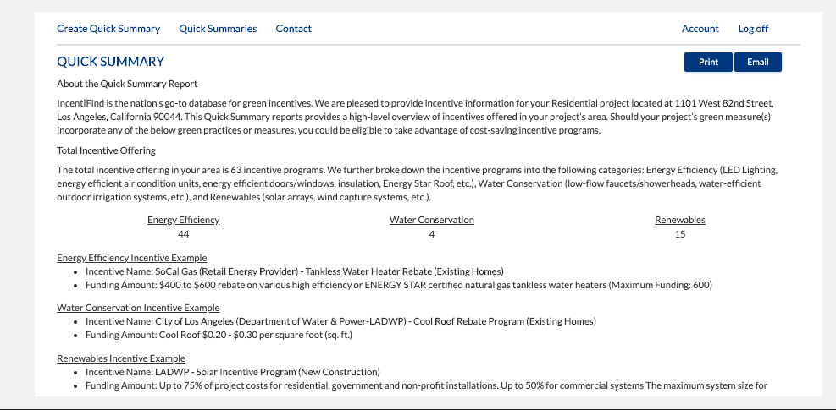
Quick Summary

Slide 15
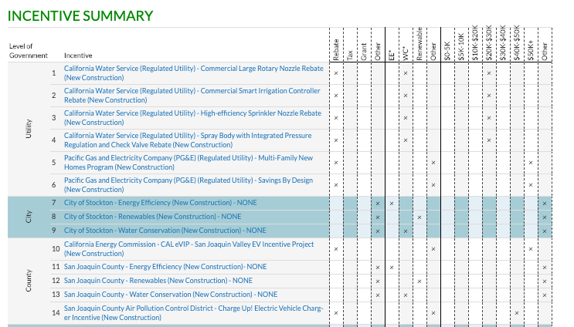
Green Report

Slide 16
Access – Quick Summary
New Vista Platform
SharperLending Users
CRA EPN Platforms
Meridian Link Users
Loans PQ
Other Platform Users
Custom Integration

Slide 17
Access – Green Report
Property Owner/ Borrower Green Report Access
CRA Customized Resource Page on Website
Custom URL on Quick Summary Product
Custom URL for direct access to the Green Report Product

Slide 18
Now What?
Reach out to New Vista Solutions:
Get questions answered
Get setup
Get onboarded
Get training and marketing materials

Slide 19
Q&A
Floor is open for questions
Additional questions may be sent to:
Jesse Rivera, jrivera@newvistasolutions.com

